Slide 1
PERSONAL EFFECTIVENESS
MAKING USE OF ALL PERSONAL RESOURCES AT ONE’S DISPOSAL TO ENABLE ONE TO ACHIEVE LIFE GOALS
FEATURES...
DOING THINGS AT HIGH QUALITY STANDARD
TAKING CARE OF FAMILY AND MAKING HAPPY
DOING CAREER ADVANCEMENT
INFLUENCING PEOPLE
ENLARGING FRIEND CIRCLE
RESPECTING EVERY HUMAN BEING
EXPERTISING IN AREA OF INTEREST

Slide 2
PERSONAL EFFECTIVENESS
ELEMENTS…
DETERMINATION
SELF CONFIDENCE
PERSISTENCE
STRESS MANAGEMENT
PROBLEM SOLVING
CREATIVITY
IDEA GENERATION
TIME MANAGEMENT

Slide 3
PERSONAL EFFECTIVENESS
Dimensions…
SELF DISCOVERY
SELF ESTEEM
GOAL SETTING
STRESS MANAGEMENT

Slide 4
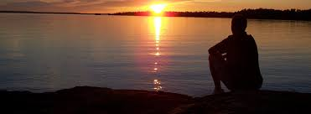
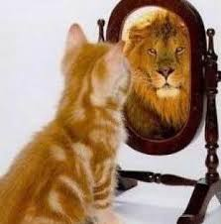
PERSONAL EFFECTIVENESS SELF DISCOVERY

Slide 5
PERSONAL EFFECTIVENESS SELF DISCOVERY
WHO AM I…….
WHAT AM I…….
HOW AM I……

Slide 6
PERSONAL EFFECTIVENESS SELF DISCOVERY
MY ENERGY
MY POSITIVES
MY STRENGTHS
MY INTEREST
MY SKILLS
MY ATTITUDES
MY FEELINGS
MY DRIVES
MY ABILITIES
MY BELIEFS
MY KNOWLEDGE
MY ACHIEVEMENTS
MY NEGATIVES
MY WEAKNESSES
MY DEFECTS

Slide 7
PERSONAL EFFECTIVENESS SELF DISCOVERY
JOSEPH LUFT AND HARRY INGHAM WINDOW
(JOHARI WINDOW)
OPEN: I KNOW - OTHERS KNOW
UNKNOWN: I DO NOT KNOW-OTHERS DO NOT KNOW
UNSEEN: I DO NOT KNOW - OTHERS KNOW
HIDDEN: I KNOW – OTHERS DO NOT KNOW
ASSUMED: OTHERS’ BELIEF OF ME

Slide 11
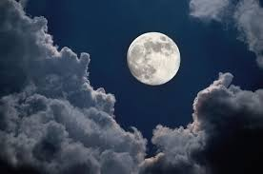

Slide 12
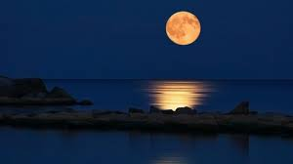

Slide 13
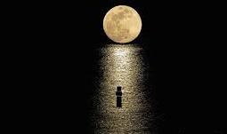

Slide 14
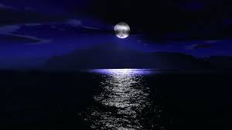

Slide 15
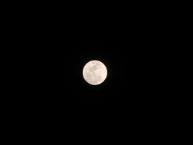

Slide 16
PERSONAL EFFECTIVENESS SELF ESTEEM
HOW ONE SEES AND THINKS ABOUT ONESELF
HOW DO I THINK OF ME
AM I PRIDE OF MYSELF
AM I HAPPY FOR WHAT I AM
HOW DO I FEEL WHEN I LOOK AT ME ON MIRROR
DO I SATISFY WITH MY PHYSICAL APPEARANCE
DO I FIND PLEASURE ON MY CHARACTER
Do I like me or hate me

Slide 17
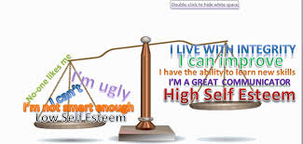

Slide 18
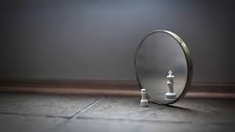
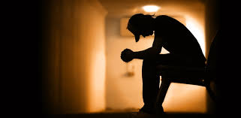

Slide 20
Self esteem
Positive negative

Slide 21
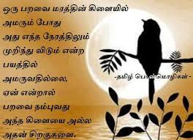
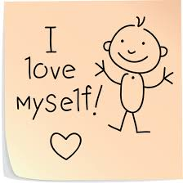
Positive self esteem

Slide 22
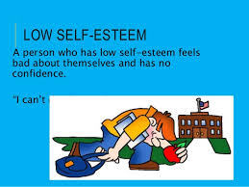
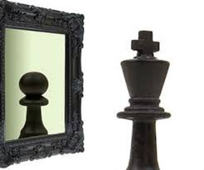
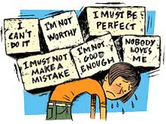
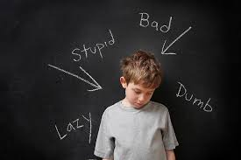
Negative self esteem

Slide 23
Positive self esteem
Feel worthy
Feel capable
Leading any
Healthy self concept
Articulation
Responsible
Concern for others
Healthy coping skills
Goal orientation
Talk about ideas
Caring attitude
humility
Respecting everybody
Courage of conviction
Character concerned
Assertive
Self interest
Optimistic
Understanding
Willing to learn
Sensitive
Solitude
discuss

Slide 24
Negative self esteem
Heavy self criticism
Dissatisfaction
No honest
Hypersensitivity to criticism
Chronic indecision
Excessive
Perfectionism
Neurotic guilt
Vulnerable
Talk about people
Critical attitude
Lonely
Arrogance
Rebels against any
Goes along to get along
Confusion
Reputation concerned
Aggressive
Blaming whole world
Selfish
Fatalistic
Greedy
Know it all
Touchy
argue

Slide 25
To build positive esteem
Know myself
Understand what makes me feel great
Recognise things that get me down
Set goals to achieve what I want
Develop trusting friendship that makes me feel good
Do not be afraid to ask for help
Stand up for my beliefs and values
Help someone else
Take responsibility for my actions
Set positive Affirmations
Step out the environment if needed
Distract mind by doing things
Keep moving or make short walk around
Be around people
Take good care of myself

Slide 26
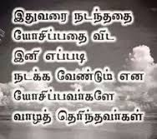

Slide 27
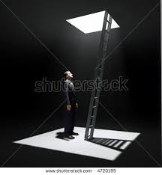
GOAL SETTING
an action PLAN designed to MOTIVATE and GUIDE a person or group toward a GOAL
IT IS THE PROCESS GIVES THE CLEAR ROAD MAP TO REACH THE GOALS
PERSONAL GOAL AND PROFESSIONAL GOAL

Slide 28
WHY GOAL SETTING….
IT GIVES LONG TERM VISION AND SHORT TERM MOTIVATION
IT GIVES POSITIVE ENERGY AND GET INTO HABIT
IT GIVE CLARITY ON THE PURPOSE OF LIFE
IT HELPS REALISE DREAMS AND VISIONS

Slide 29
HOW…
CAPTURE THE VISION OF LIFE
SET LARGE GOALS TO ACHIEVE IN LIFE TIME
PRIORITISE THE GOALS
ASSESS THE ATTAINABILITY OF GOALS

Slide 30
Formula of smart in goal setting
S : Specific
m : Measurable
A : Achievable
R : Realistic
T : Timely
“to sail around the world”
“To have completed my trip around the world by December 31, 2016”

Slide 31
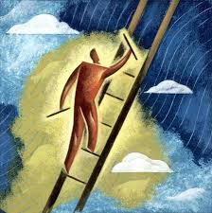
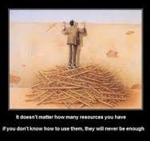
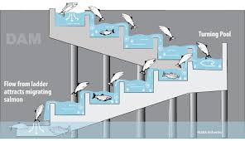

Slide 32
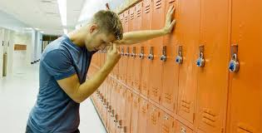
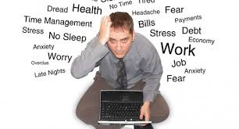
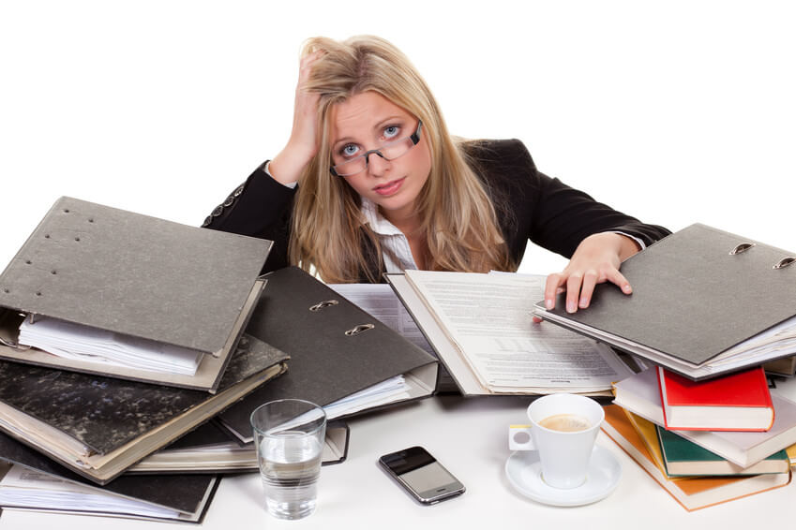
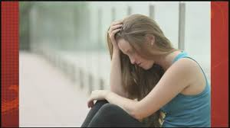
Stress management
What is stress

Slide 33
What is stress…
Normal physiological response of body to situations which is dangerous to self
Positive stress and negative stress
Leads to happy ending - leads to sad ending

Slide 39
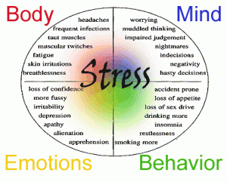

Slide 40
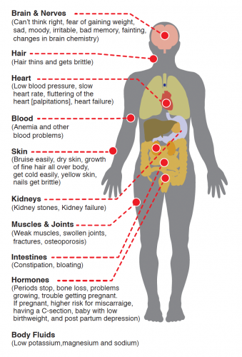
Effects of Stress…

Slide 41
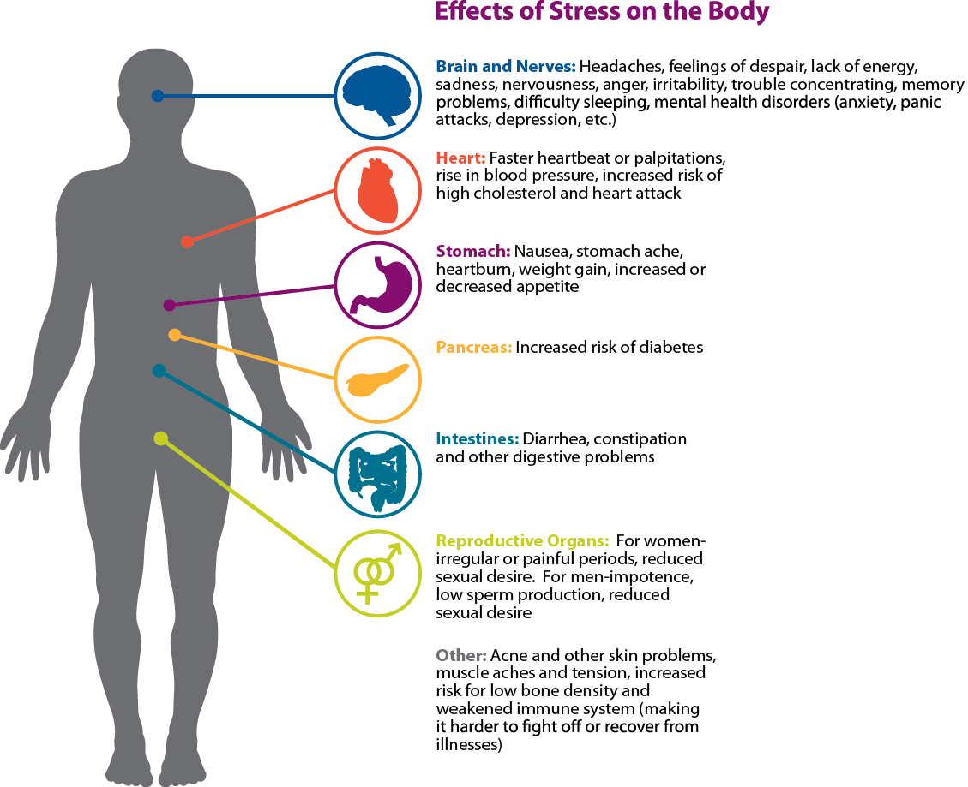
Effects of stress

Slide 42
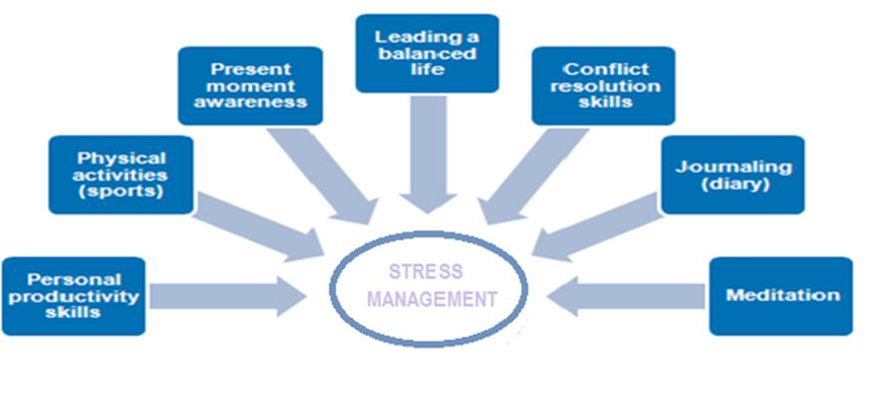
Stress management…

Slide 43
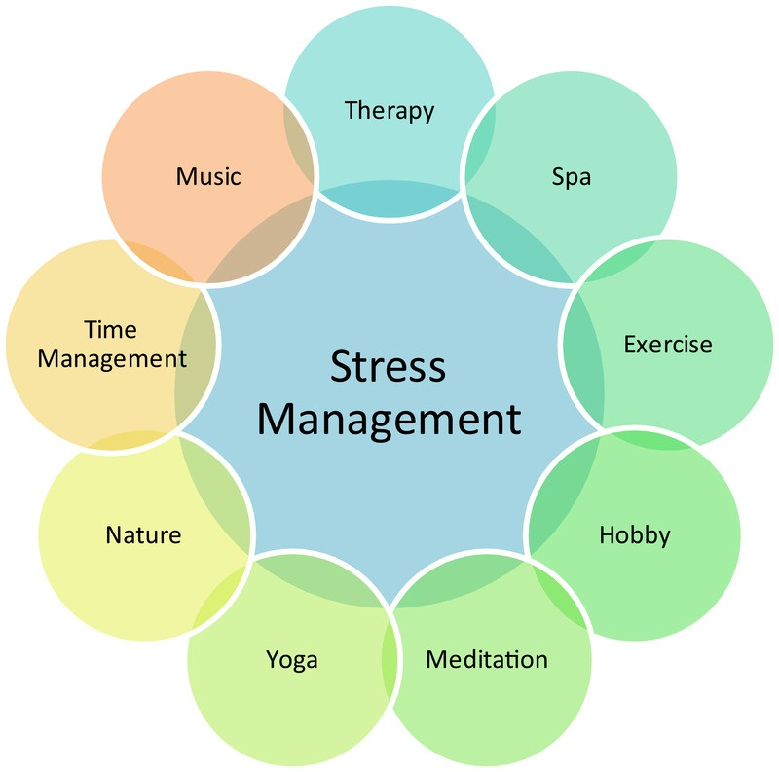
Stress management
Stress management

Slide 44
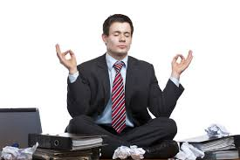
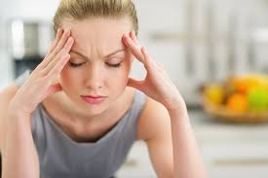
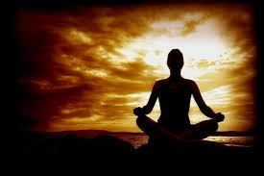

Slide 45
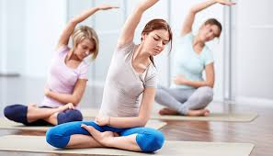
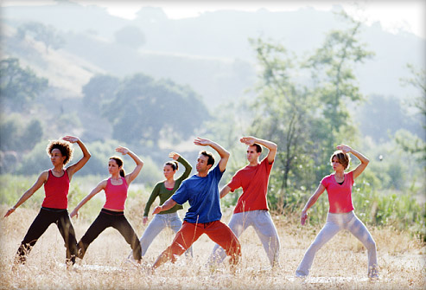
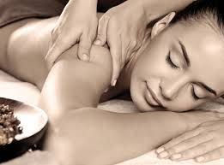

Slide 46
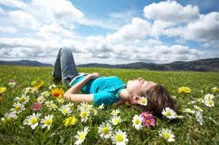
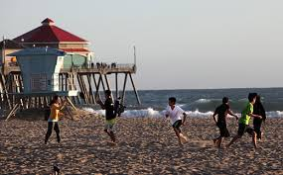
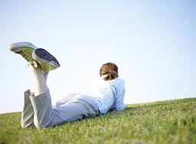
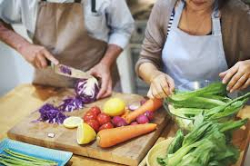

Slide 47
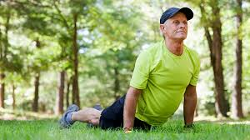
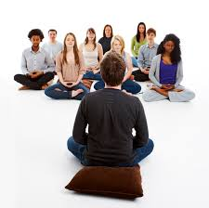
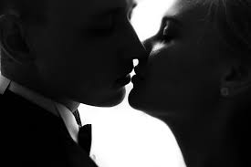
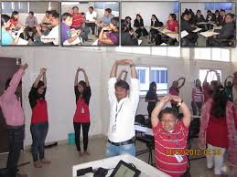

Slide 48
Stress management
Bathing
Swimming
Playing games
Temple massage
Finger into years
Head massage
Breathing
Body massage
Stretching
Nature watching
Bird watching
Watching animals
Ball pressing
Sky watching
Lying eyes closed
Walking in the rain
Talking with loved ones
Going out with friends
Meditating
Sexual intercourse

Slide 49
Thank you
Have a happy life

